Slide 1
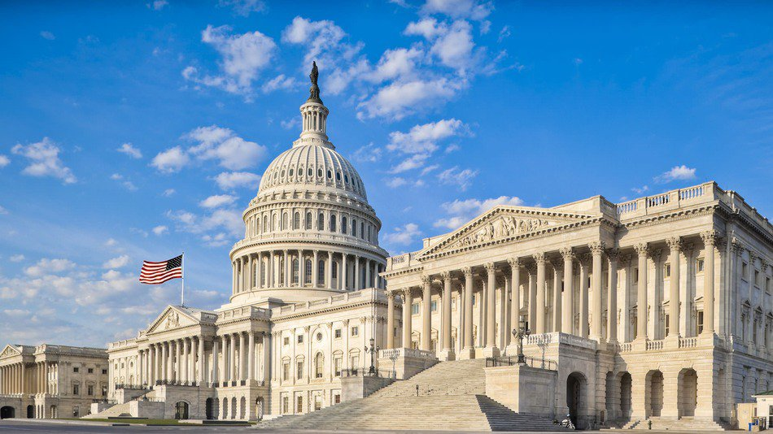

2016 Legislative Session
ADVOCACY
toolkit

Slide 2
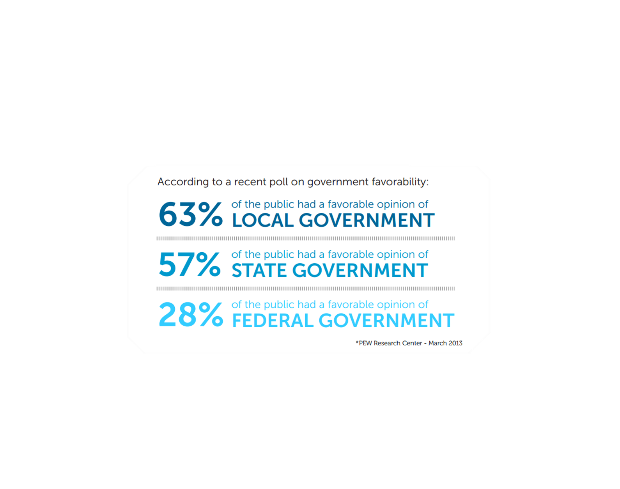
Local Government Matters to the People!

Slide 3
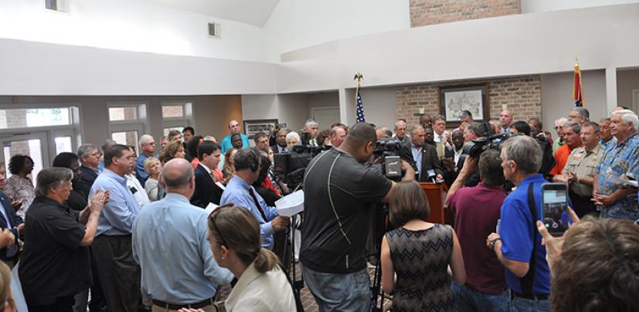
More Than 75 Years of Serving Mississippi Counties
The Purpose of MAS
The purpose of the Association is to advertise and bring into favorable notice the opportunities of the various counties of the State; to promote the interest and general welfare of the State; to interchange ideas and to develop, as far as practicable, a uniform system of county government throughout the State; to maintain a Statewide agency for the purpose of advancing the moral, financial, and general welfare of the State, and the counties of the State; and to create and promote a feeling of fellowship, sympathy, and understanding among and between the counties and the people of the State of Mississippi. The Association shall be non-political.

Slide 4
The Value of YOUR Legislative Services
Access to Information:
In addition to the general lobbying efforts by The Mississippi Association of Supervisors (MAS) staff, MAS staff members also have daily contact with members of the Mississippi Legislature and their staff during the Regular Legislative Session. This close knit relationship keeps your Association in the inner circle of most issues.
Grassroots Lobbying:
The most effective means of a membership organization’s legislative efforts is grassroots lobbying. This is an important part of MAS’s policy efforts on behalf of all 82 counties. MAS coordinates 10 major legislative visits to the Mississippi State Capitol. This visit give MAS members an opportunity to observe the legislative process, and meet with their local legislative delegation to discuss local issues and statewide issues impacting county government.
Legislative Updates & Call to Actions:
During the course of the Regular Legislative Session (and sometimes outside of the session), you will periodically receive a legislative update or a “call to action” message via email, text message, or fax asking you to contact your local HOUSE or SENATE members to convey a position on an issue pertinent to county government.

Slide 5


2016 Mid-Winter Conference
OUR STATE’S 82 COUNTIES STAND READY TO WORK TOGETHER TO NOT ONLY ENSURE A ROBUST INTERGOVERNMENTAL
PARTNERSHIP, BUT TO ALSO LEVERAGE OUR COLLECTIVE STRENGTHS
TO HELP MEET THE CHALLENGES AHEAD.
Connect with Us!
2016. GET INVOLVED.
#countiesconnectMS
793 NORTH PRESIDENT STREET JACKSON, MS 39202 601.353.2741 FAX 601.3932630 WWW.MSSUPERVISORS.ORG

Slide 6
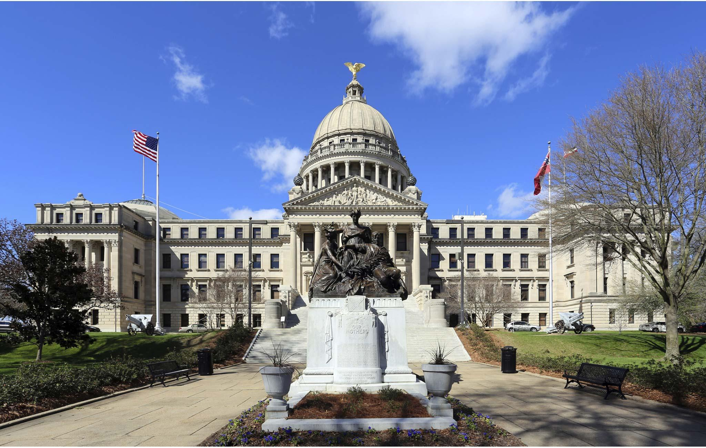
State Leadership Links
Contact the GOVERNOR at the link below
http://www.governorbryant.com/
Contact the LT. GOVERNOR at the link below
http://www.ltgovreeves.ms.gov/Pages/Home.aspx
To find your HOUSE member click the link below
http://billstatus.ls.state.ms.us/members/hr_membs.xml
To find your SENATE member click the link below
http://billstatus.ls.state.ms.us/members/ss_membs.xml
For other legislative inquiries click the link below
http://www.legislature.ms.gov/Pages/Contact.aspx

Slide 7
Committees in the State Legislature Vital
to County Government
Senate
County Affairs
“Contact your local legislative delegation to see if they serve on any of these committees. If they do serve, request that they support all legislation that’s favorable toward county government, and to oppose all legislation that poses a negative impact to county government ”
House
County Affairs
Senate
Appropriations
House
Appropriations
Senate
Finance
House
Ways and Means
Senate
Transportation
House
Transportation
Senate
Energy
House
Public Utilities

Slide 8
Know Your Association’s Legislative
Committee Members
The Legislative Committee is responsible for the preparation and recommendation of a proposed legislative program for consideration of the membership at its Annual Membership Meeting. The 11 members of the Legislative Committee are elected at the spring regional meetings and serve one-year terms. The First Vice President is an ex-officio, nonvoting member of the Legislative Committee.
The 2015-2016 Legislative Committee members are:
Mike Huddleston, Chair, Prentiss County
Bobby Bolton, Perry County
Vacancy
Butch Graves, Amite County
Kenneth Harris, Vice Chair, Newton County
Melton Harris, Jr., Jackson County
Billy Kirkpatrick, Monroe County
Michael Lott, Grenada County
Bill Newson, Sharkey County
Curtis Skiffer, Simpson County
Orlando Trainer, Oktibbeha County

Slide 9
2016 Regular Legislative Session

Slide 10
Legislative Budget Office
Fiscal Year 2017
As adopted by the Governor and the Joint Legislative Budget Committee totals $6,2 billion and reflects and increase in anticipated revenue of 1.9% above the revised Fiscal Year 2016 revenue estimate.
(1.9% anticipated increase is an additional $106 million.)
Homestead Exemption Reimbursement
2015 Actual | 2016 Estimated | 2017 Requested | 2017 Recom.
$84,454,641.00 | $84,454,641.00 | $87,500,000.00 | $84,454,641.00
Reimbursement for Local Confinement
2015 Actual | 2016 Estimated | 2017 Requested | 2017 Recom.
$11,305,533.00 | $7,391,250.00 | $5,462,134.00 | $5,462,134.00

Slide 11
The Reality of the Situation
Current budgeted fiscal year ending in June 30 will come up $64 million dollars short.
Medicaid was not funded enough, it will come up $70 million short.
NOTE: Medicaid spending has grown by more than $425 million in four years (Still the challenge of adequately funding IHL and K-12)
If current 2016 projections hold, the Governor will be required to make a $64 million statutorily mandated across-the-board cuts.

Slide 12
Politics to Consider
There may be more pressure to increase revenue for K-12 funding due to the recent efforts of Initiative 42.
The Mississippi Economic Council along with local and state government entities will make a hard push for more infrastructure funding in the form of a tax and fee increases.
There will be more pressure to eliminate more business taxes, more specifically the corporate franchise tax.
This tax levies $2.50 on each $1,000 of a corporation’s capital and property.
This tax brings in $242 million a year to the state.

Slide 13
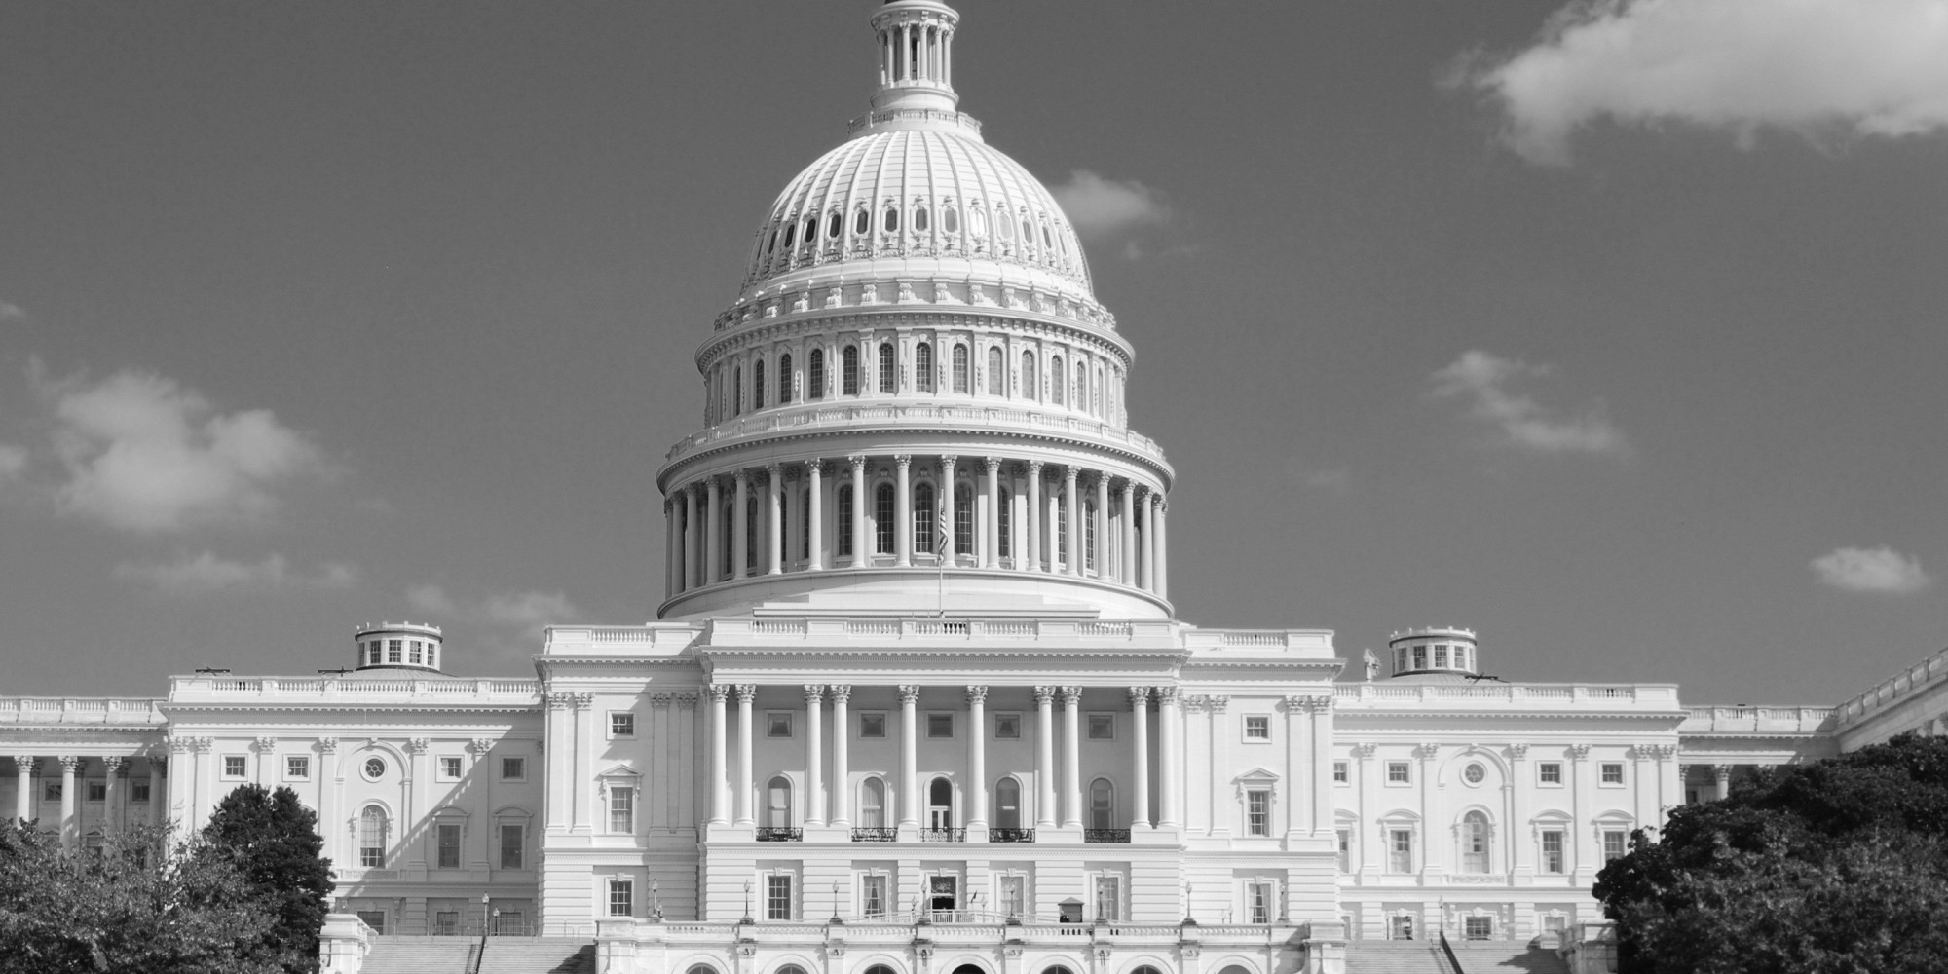

POLICY and
LEGISLATIVE
BRIEFS
TABLE of CONTENTS
ADEQUATE and LONG-TERM INFRASTRUCTURE FUNDING…………………………………………….. 1
COUNTY GOVERNMENT EDUCATIONAL
CERTIFICATION PROGRAM……………………….. 2
APPROPRIATION FUNDING…………….…………. 3
911 FUNDING…………………….………………..… 4
UNFUNDED MANDATES……………..…………..… 5

Slide 14
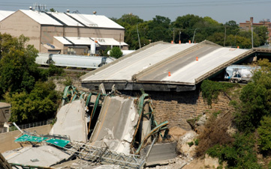
Long Term Infrastructure Funding
1
County Interest
Mississippi county government maintain roughly 70% of all public roads with the State. Yet, the amount of revenue needed to adequately maintain the locally owned county road remains insufficient.
Status
Currently, both the public and private sector have joined forces through an initiative titled “Blue Print Mississippi” to produce a comprehensive report that will map out a long-term infrastructure funding plan for the 2016 Regular Legislative Session.
Talking Points
Request that your local legislative delegation support adequate long term funding for county infrastructure.
Also request that your local legislative delegation support $40 million dollars in funding for the Local Systems Bridge Program (LSBP)

Slide 15
Long Term Infrastructure Funding
Cont’d
County
2,989 locally owned substandard bridges
2,200 posted bridges below weight limits they were designed to handle
City
138 functionally obsolete bridges
105 structurally deficient bridges
30 posted bridges below weight limits they were designed to handle
State
936 bridges in some state of disrepair
191 posted bridges below weight limits they were designed to handle

Slide 16
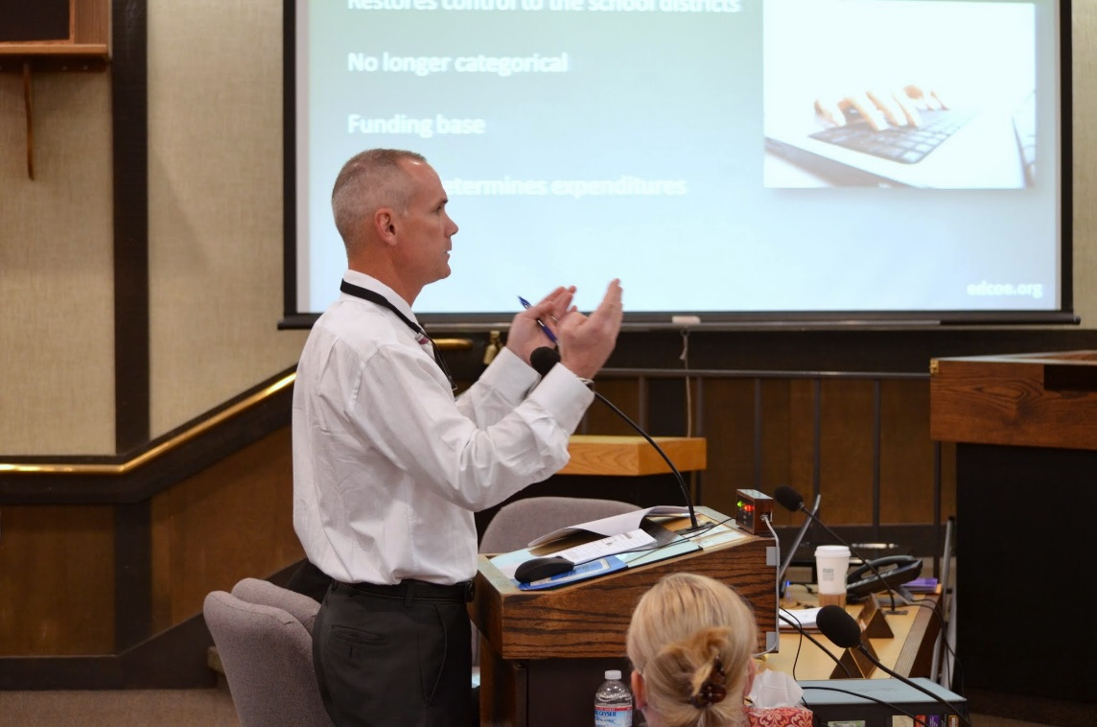
County Government
State Certification Program
2
County Interest
In a time when new State & Federal regulations, policies, and mandates, whether directly or indirectly constantly impact local government, the need for a continuous university driven and state certified educational program becomes more of a need rather that an option.
Status
The Mississippi Association of Supervisors are currently working with Mississippi State University’s Center for Governmental Technology to establish a County Government Educational Certification Program
Talking Points
Request that your local legislative delegation support a educational certification program for county government.

Slide 17

Appropriation Funding
3
County Interest
Appropriation funding from the Mississippi State Legislature is a crucial component to county government. From statutorily mandated reimbursements to other forms of line item appropriations, MAS works diligently with the Mississippi Legislature to ensure the financial needs of Mississippi counties addressed.
Status
The Mississippi Association of Supervisors continues to work closely with the Mississippi Legislature to receive full funding for the Homestead Exemption Reimbursement.
Talking Points
Request that your local legislative delegation support fully funding the homestead exemption reimbursement as mandated by current law. It was $3 million short of full funding for the 2015 Regular Legislative Session.

Slide 18
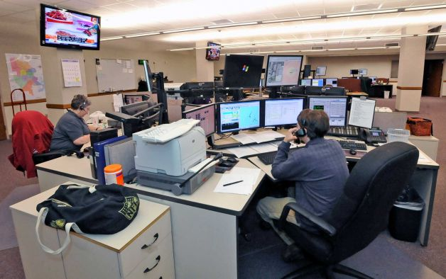
911 Funding
4
County Interest
Providing efficient and effective 911 emergency management services is a crucial service component of county government. As Mississippi communities continue to grow, the demand for 911 services will inevitably increase.
Status
Currently, counties across the state are seeing a huge shortfall in their 911 funding due to how counties receive their funding from a $1.00 surcharge that’s attached to wireless devices.
Talking Points
Request that your local legislative delegation support restructuring the $1.00 surcharge formula on wireless devices as it relates to counties receiving more money.

Slide 19

Unfunded Mandates
5
County Interest
For years county government has continued to battle mandates handed down from the state level of government that requires service without any revenue attached to it. It has become a core policy of county governments to oppose all unfunded mandates.
Status
Currently, special interests groups tend to message the mainstream media on attractive initiatives as it relate to economic development. MAS works diligently to sift through the misinformation to inform the public of various direct and indirect unfunded mandates these special interest initiative tend to hide .
Talking Points
Request that your local legislative delegation oppose all unfunded mandates. Also, request that your legislative delegation oppose all legislative measures that have the potential to cause an unfunded mandate.

Slide 20

Media Tools
While your local legislative delegation are back in their local district outside of the legislative session, or while they are in session, county supervisors have a great opportunity to work with the local media outlets to draw attention to key State policy priorities.
Submitting an op-ed or guest commentary to local papers is an excellent way to express county issues and views in a highly-visible way. For a short sample guide on writing an op-ed, visit: http://www.naco.org/sites/default/files/documents/WotusOpEdGuidance.pdf
You may also Visit: http://www.naco.org/sites/default/files/documents/NACO_MediaGuide2013.pdf to obtain a Media Relations Guide for Counties from the National Association of County Officials (NACo) website.

Slide 21


Mississippi
Association of Supervisors
Why Regional Visits?
Visits at the Capitol are designed to give you, Mississippi county supervisors, an opportunity to spend time with your legislators, attend important committee meetings, get briefed on key issues by MAS, and become involved in the legislative process.
Strong County Government for a Growing State
2016 County Regional Visits
@ The Capitol
The Day of the Visit …
9:00 am – Meet MAS staff on the first floor of the Capitol, once you pass the security check.
MAS staff will provide a brief verbal briefing in addition to handouts highlighting the grassroots assignments for that day (important committee meetings to attend, and key legislators to target)
Be sure to visit either the Senate or House chamber if they are in session, and ask that your legislator recognize you from the House or Senate gallery.
Once you have completed the handout assignments, please invite your legislators back to the MAS office for lunch.
During lunch, MAS staff will provide a more detail legislative update.
Tuesday, January 12th Golden Triangle PDD
Wednesday January 20th Southwest PDD
Tuesday, January 26th East Central PDD
Tuesday February 2nd Three Rivers PDD
Wednesday February 3rd Southern PDD
Tuesday February 9th Northeast PDD
Tuesday February 16th North Central PDD
Tuesday February 23rd Central PDD
Tuesday March 1st South Delta PDD
Tuesday March 8th North Delta PDD

Slide 22

Important Checklist
Lock in your local legislators cell phone numbers.
Email, text, or call your local legislators at least once a week for feedback on your legislative concerns.
Make sure your local legislators always know your local concerns as well as concerns impacting counties statewide.

Slide 23
2016 LEGISLATIVE PROPOSALS

Slide 24
2016 Legislative Proposals
Proposal 1
The Mississippi Association of Supervisors requests legislation that establishes a state certified county supervisor’s education certification program.
Proposal 2
The Mississippi Association of Supervisors requests legislation that increases infrastructure funding to county government beyond its existing funding stream.
Proposal 3
The Mississippi Association of Supervisors request legislation funding the Local Systems Bridge Program (LSBP) at $40 million.

Slide 25
2016 Legislative Proposals
Proposal 4
The Mississippi Association of Supervisors request legislation that fully funds the Homestead Exemption Reimbursement at $87.5 million.
Proposal 5
The Mississippi Association of Supervisors request legislation that provides for increased revenue for 911 funding.
Proposal 6
The Mississippi Association of Supervisors request legislation that provides for the 2016 round Rural Fire Truck funding.

Slide 26
2016 Legislative Proposals
Proposal 7
The Mississippi Association of Supervisors request legislation that provides funding for the Beaver Control Assistance Program (BCAP).
Proposal 8
The Mississippi Association of Supervisors request legislation that increases from $5,000 to $15,000 purchases made that does not require 2 competitive bids .

Slide 27
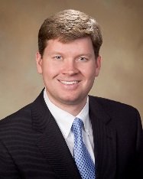
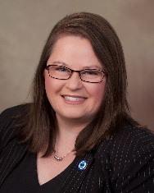
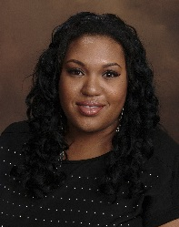
State Association Contacts
Derrick Surrette
Executive Director
dsurrette@massup.org
Stephanie Spangler
Director of Member Services
sspangler@massup.org
Steve A. Gray
Director of Governmental Affairs
sgray@massup.org
Renada Skannal
Administrative Assistant
rskannal@massup.org
Donna Hopkins
Director of Finance
dhopkins@massup.org
Brooks Miller
Risk Management Specialist
rskannal@massup.org
Leslie Scott
General Counsel
lscott@massup.org
MAS Website
http://www.mssupervisors.org/

