Slide 1
EPA’s Clean Power Plan
Mark Loughman
Director of Environmental Affairs

Slide 2

Population 2015
More people live inside the circle than outside…

Slide 3
Global Energy Demand in Perspective
191 ⁹⁹
156
57
267
207
880
1017
517
468
64
975
78
820
289
10
5
371
376
1389
3
1
Oil
Natural Gas
Coal
Nuclear
Hydro
Renewables
98
24
167
111
166
16
302
2609
562
5
28
149
(MTOE)

Slide 4
Clean Power Plan
Vast overreach of Clean Air Act
Little to no climate benefit
42% reduction in emissions by 2030
Customers and Energy Industry
Economic development impacts
Aggressive assumptions used to set targets
Job losses
No economic dispatch
Higher rates for customers

Slide 5
Mississippi Impacts
MS target seems punitive
  Less than NSPS - inconsistent with intent of CAA
  18 states final targets higher than 2012 CO₂ emission rate
Electric System Redesign
  Undermines MPSC authority
  Assumes retirement of existing MS coal fleet*
  Loss of fuel diversity would hurt consumers
  Possibly stranded assets
  Forced reliance on expensive renewables and EE

Slide 6

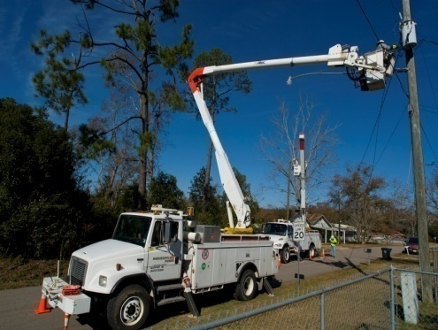
Mississippi Numbers
3,400
Jobs
$14+
Billion
“Energy is the lifeblood of our country, the soul of our economic development.”
- Phil Bryant, Governor of Mississippi
“Energy security – affordable, available, reliable, sustainable – drives the energy mix and should be the goal of energy policy.”
- Dr. Scott Tinker, University of Texas
14 -18%
Estimated
rate increase
Income spent on energy
22%

Slide 7
Economic Impacts
Reliance on out-of-state power
Loss of competitiveness (manufacturing flight)
Most expensive environmental regulation ever proposed on the industry
  Estimated U.S. compliance costs $423 billion by 2030
  Estimated U.S. electricity rate increases 12-17%
  Job losses estimated at 224,000 per year
Especially hard on middle- and low-income families

Slide 8
The Bottom Line
Costs will increase if finalized
Enormous federal overreach by EPA into states’ authority
Unworkable in its current form
Does not serve customers’ interests
  Higher electricity rates
  Impaired reliability
EPA should withdraw the proposal and re-propose guidelines consistent with the Clean Air Act

Slide 9
Questions?

Slide 10
Proposed Implementation Timeline

