Slide 1
01
MAS Institute for Excellence
in County Government
SUPERVISORS' CERTIFICATION PROGRAM
Derrick Surrette

Slide 2
02
What is the Certification Program?
Created by staff and Board of Directors in 2019.
Launched at 2019 New Term Orientation.

Slide 3
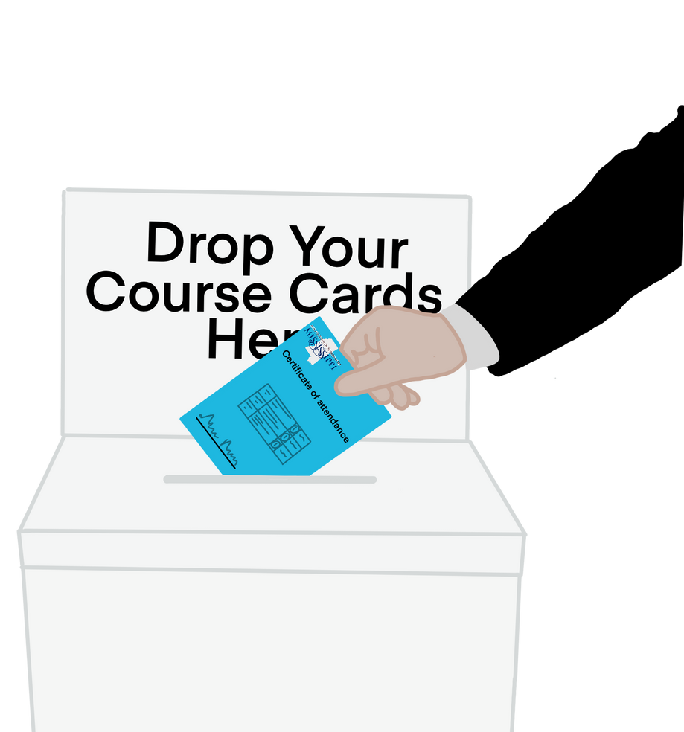
03
How does it work?
To get credits...
Complete and turn in
course card
Sign up for a Webinar course.
or

Slide 4
04
What are the requirements?
-Ten core courses (required)
-Thirty elective courses
-Total of 40 CEUs
-Designed for completion in one term

Slide 5
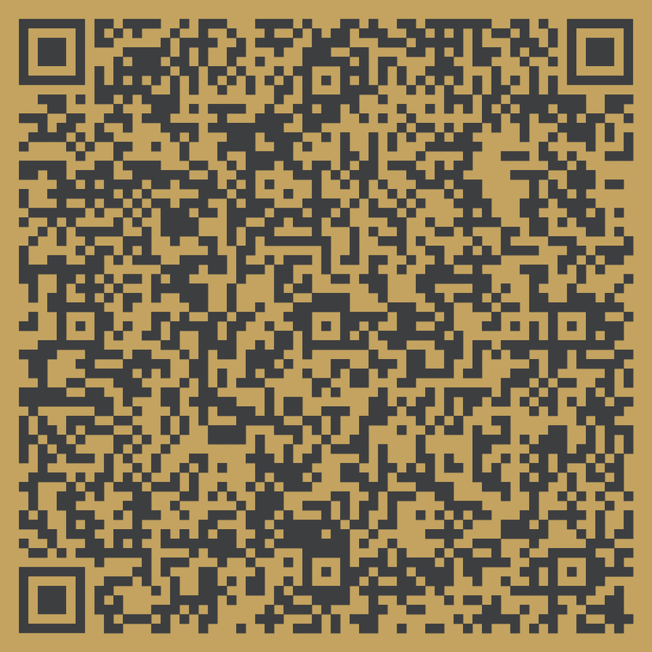
05
Do you want your transcript?
You can...
Email: sspangler@massup.org
Text: 601.668.0671
Scan this QR code to request your transcript.
Find her today at On-Site

Slide 6
06
2023 Inaugural
Graduation Ceremony
-Will be held at the 2023 Annual Convention during the Honors Ceremony.
-All certified Supervisors will be recognized.

Slide 7
07
Phase 2:
Under development

