Slide 1

MAS Convention
2015
Mississippi Office of the State Auditor
Stacey Pickering, Auditor

Slide 2
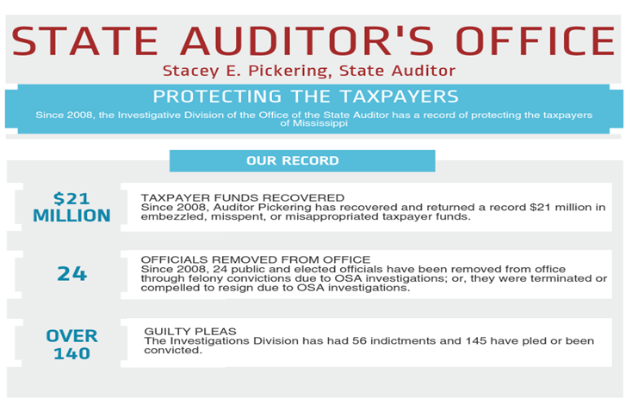

Slide 3
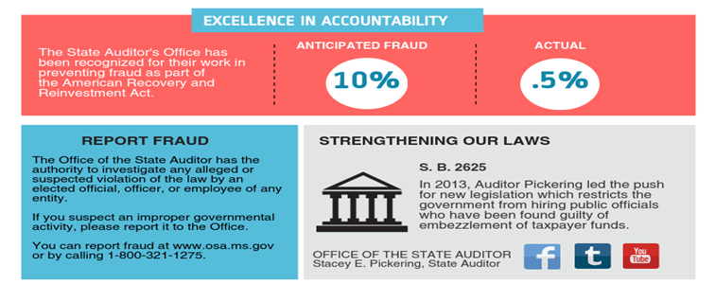

Slide 4
SPECIAL Laws Related to the Last Year of a Board of Supervisor’s term

Slide 5
§ 19-11-7. Preparation and publication of annual budget.
  FOR BEAT SYSTEM COUNTIES:
The board of supervisors shall not prepare a budget that reduces the county budget by more than twenty percent (20%) in the last year of the members' term of office if a majority of the members of the board are not reelected.

Slide 6
§ 19-11-7. Preparation and publication of annual budget.
FOR UNIT SYSTEM COUNTIES:
The county administrator shall not prepare a budget that reduces the county budget by more than twenty percent (20%) in the last year of the members' term of office if a majority of the members of the board are not reelected.

Slide 7
§ 19-11-27. Certain expenditures for last year of term limited.
No board of supervisors of any county shall expend from, or contract an obligation against, the budget estimates for road and bridge construction, maintenance and equipment, made and published by it during the last year of the term of office of such board, between the first day of October and the first day of the following January, a sum exceeding one-fourth (1/4) of such item of the budget made and published by it, except in cases of emergency.

Slide 8
§ 19-11-27. Certain expenditures for last year of term limited.
No board of supervisors nor any member thereof shall buy any machinery or equipment in the last six (6) months of their or his term unless or until he has been elected at the general election of that year. The provisions of this section shall not apply to a contract, lease or lease-purchase contract executed pursuant to the bidding requirements in Section 31-7-13 and approved by a unanimous vote of the board. Such unanimous vote shall include a statement indicating the board's proclamation that the award of the contract is essential to the efficiency and economy of the operation of the county government.

Slide 9
§ 19-13-17. Purchase of road equipment.
Whether a beat or unit county, no installment contract for the purchase of road equipment may be executed by the board during the last year of the board's term of office.

Slide 10
§ 19-13-21. Repairs of road equipment.
… any repairs herein permitted to be made after the first day of July of the last year of the term of office of the members of the board making such repairs shall exceed the sum of Five Thousand Dollars ($5,000.00), the repairs shall not be made unless and until the board of supervisors, or a majority of the members thereof, shall have authorized the making of the repairs at a regular meeting of the board, or a special meeting called for that purpose.

Slide 11
§ 23-15-881. Prohibitions against excessive expenditures or hiring of workers for state highways or public roads; maintenance of records.
It shall be unlawful for the … board of supervisors of any county or any member of the board of supervisors of such county, to employ, during the months of May, June, July and August of any year in which a general primary election is held for the nomination and election of members of the State Highway Commission and members of the boards of supervisors, a greater number of persons to work and maintain the state highways, in any highway district, or the public roads, in any supervisors district of the county, as the case may be, than the average number of persons employed for similar purposes in such highway district or supervisors district, as the case may be, during the months of May, June, July and August of the three (3) years immediately preceding the year in which such general primary election is held.

Slide 12
§ 65-9-19. Contracts.
Contracts for the construction of state aid road projects shall be advertised and let by the board of supervisors of any county desiring so to do, in the manner now required by law but subject to the approval of the State Aid Engineer; however, during the last six months of the boards of supervisors' terms of office, no contracts for state aid projects shall be awarded unless construction programs embracing such projects shall have been adopted by the boards and approved by the State Aid Engineer in writing prior to July 1 of said year.

Slide 13
§ 65-7-95. Methods of construction and maintenance.
In no event shall any contract for road construction and maintenance be awarded that shall extend beyond thirty (30) days from the termination and end of the term of office of the members of the boards of supervisors awarding same.

Slide 14
PUBLIC HOSPITAL ISSUES

Slide 15
Rural Public Hospitals: The Study
Rural public hospitals play a vital role in our local communities
Financially strong hospitals offer the best possibility for good health services
Good information about a hospital’s financial health can help:
  Identify best practices
  Focus attention where it is most needed
  Identify efficiencies

Slide 16
Rural Public Hospitals: The Study
OSA created an analytical method to study 25 rural, publicly owned hospitals using
  Profitability
  Liquidity
  Capital structure
  Solvency
Mostly Good
  Average hospitals studied are above national average for rural, public hospitals
  60% of hospitals in the study did better than national median

Slide 17
Rural Public Hospitals: The Study
Some Concern
  Four hospitals made financial watch list:
    Tippah County Hospital
    Tallahatchie County General Hospital
    Natchez Regional Medical Center
    Montfort Jones Memorial Hospital (Attala County)
  Of those,
  While not a rural hospital, publicly owned, Singing River Hospital would likely have also fallen into the financial watch list category if it had been part of the study

Slide 18
Watch List Hospitals’ HEadlines
“Despite state report, Tallahatchie General Hospital strong”
  Has improved its financial position, since the study
“NMHS takes over Tippah County Hospital”
Montfort Jones
  “Mississippi's rural hospitals face uncertain future”
  “Rural Hospital Looking For Help To Keep it From Closure”
  “Kosciusko hospital latest to lay off workers”
Natchez Regional
  “Natchez Regional Medical Center Files for Bankruptcy Again”
  “Natchez Regional system is broken beyond repair
  “County approves hospital sale”

Slide 19
Rural Public Hospitals: The Future
Population and Demographics
  Decreasing census—inpatient service demands declining for decades
  Excess inpatient capacity—MS currently has 3,000-5,000 more inpatient beds than needed
Economy
  More than 70% of all government owned, Mississippi hospitals have reported operating losses in the last 2 years
  Decreasing revenues?

Slide 20
Rural Public Hospitals: The Future
Medicare Payment Structures
  Based on the national average cost for all hospitals; so that the “average” hospital can thrive
  Below that “average”? Above average costs or declining patient census? = uncertain futures
Multi-hospital systems appear to be more viable and cost effective—rarely found in public hospitals
Should locally owned, rural, public hospitals look at new models?

Slide 21
Rural Public Hospitals: The Future
Technology Changes
  Faster diagnosis, less invasive procedures, more preventative measures
  New options for treatments
  New and more sophisticated technology
  Telemedicine

Slide 22
Rural Public Hospitals: The Future
New Models of Healthcare Delivery
  Value-based models
  Federal quality care regulations
  Capital intensive needs (“average” hospital has enough profits to maintain and upgrade)
  Multi-hospital systems (cost leveraging)

Slide 23
Rural Public Hospitals: The REsults
Greater Expectations
  Requires strong, involved, management with sufficient knowledge
  Flexibility for the future
  Prepare for changing world of healthcare
Other States using OSA model
  Helping to evaluate current situation to better plan for the future

Slide 24
SENATE BILL 2407
Effective January 1, 2016
Clarifies the Open Meetings Act to include Community Hospital Boards
Provides Hospital Boards with reasons they may go into executive session
Clarifies which Community Hospital records are public records and which are exempt

Slide 25
SENATE BILL 2407
Provides for the removal of a trustee by the owner (Board of Supervisors)
Provides that each community hospital shall maintain an accountability and transparency website for the hospital. The Technical Assistance Division is currently updating our Hospital Guide to provide best practices for these websites.

Slide 26


MAS Convention 2015
Mississippi Office of the State Auditor
Stacey Pickering, Auditor
Thank You!
Follow us on Facebook and Twitter
Facebook.com/StaceyEPickering
Twitter.com/MSStateAuditor
Phone: 1-800-321-1275 Woolfolk Building, Suite 801
Email: Auditor@osa.ms.gov 501 N. West Street Web: www.osa.ms.gov Jackson, MS 39201

